Slide 1
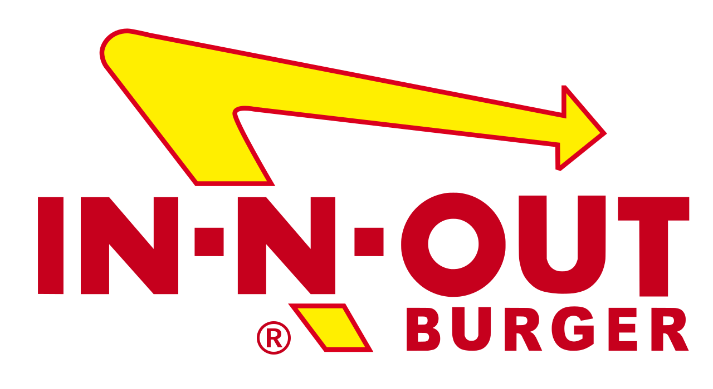
Kent Ellertson
Amanda Pineda
Jiarui Zhou
Maria Garin

Slide 2
Introduction
Target brand: In-N-Out
We have chosen this brand because of its wide popularity and good reputation. We were interested in choosing a company with a good ethical standing and thought that In-N-Out was the perfect fit
We want to investigate whether the Boston burger market is suitable for In-N-Out burger to enter the East coast and the attitude of Boston customers towards In-N-Out burger

Slide 3
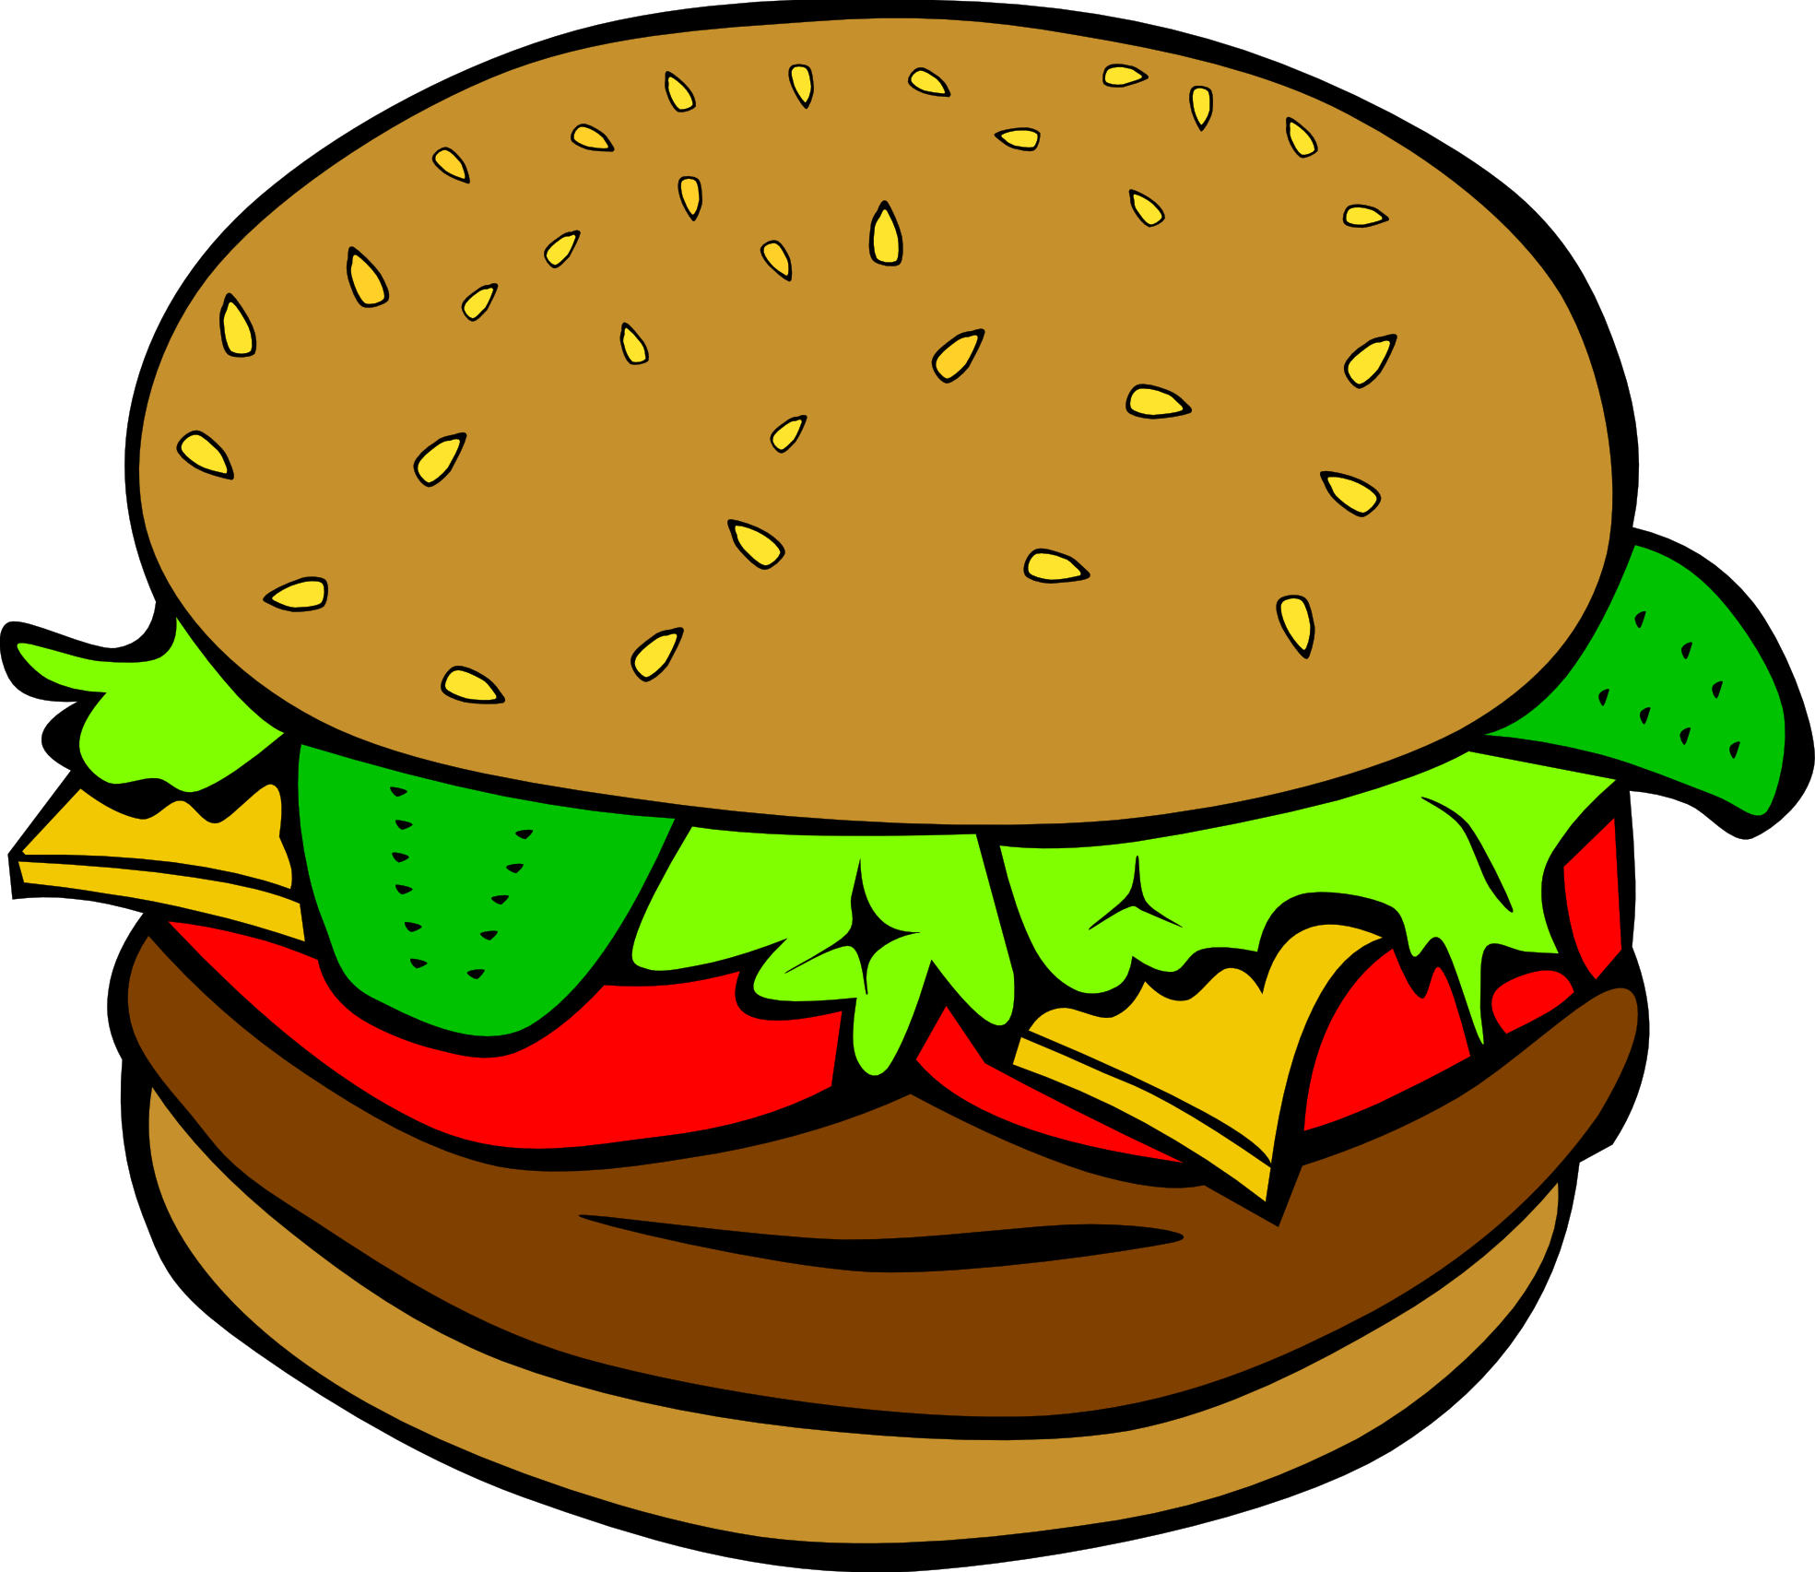
Situation Analysis
Internal analysis:
Mission: bring quality food (no freezing, no additive）
Selective expansion, no franchise (keep food quality）
External analysis:
Healthy trend in eating, rise of vegetarianism and veganism
Rise in delivery options
Competitors analysis:
McDonalds, Wendy’s, Shake Shack, Tasty Burger and Five Guys
Consumer analysis:
Mostly young people (e.g. students)
Low income group

Slide 4
Strengths and Weaknesses
Internal Analysis
Product Strengths | Product Weaknesses
Not a franchise Fresh, organic food High employee treatment Affordable with good quality Long time expertise in burger area | Exclusive Secretness of Menu Lack of diversity Fast food (considered as unhealthy) No advertisement

Slide 5
Opportunities and Threats
External Analysis
Market Opportunities | Market Threats
Organic, fresh trend (farm on table) Strong brand name Celebrities love In-N-Out | Boston pride of local brands General competition Loss of exclusivity in West Coast

Slide 6
Marketing Problems
Loss of exclusivity
In-N-Out rejects franchising
Distribution stores have to be near stores
Competition in the Boston fast food industry
Shake Shack, Tasty Burger, and Five Guys have multiple locations in the Greater Boston Area

Slide 7
Research Objectives
General
To determine how consumers react to In-N-Out’s arrival to the Greater Boston Area
Specific
To estimate how often consumers eat at burger restaurants
To identify which attributes consumers value most regarding a burger restaurant and its food
To estimate how positive consumers’ images of burger restaurants are
To assess which promotions would encourage consumers most to try In-N-Out
To estimate how often consumers saw advertisements for In-N-Out
To identify what would be consumers’ preferred locations for In-N-Out in the Greater Boston Area
To assess consumers’ favorability of the In-N-Out secret menu

Slide 8
Method
Data Collection Method
Online survey - Qualtrics questionnaire
Sampling Methods and Samples
86 Respondents aged 18 or older
34 Male, 50 Female, 2 Preferred not to say

Slide 9
Method
Key Meanings
Evaluating burger restaurant habits
Assessing motivation for favorite burgers and burger restaurants
Reactions to affordability, nutrition value, responsibility, creativity, ambiance
Gauging purchase intention
Ranking store location
Ranking promotional distribution
Data Analysis
Frequency, Crosstabs, Independent T-test, One-Way ANOVA

Slide 10
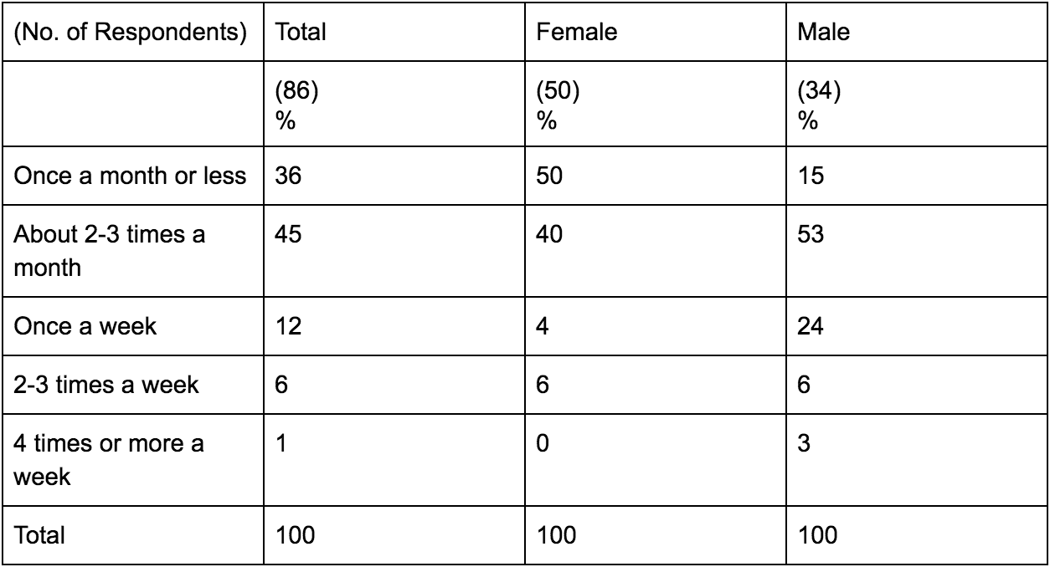
Results (Before Concept Board)
Frequency of Burger Consumption
Notes:
Kent

Slide 11
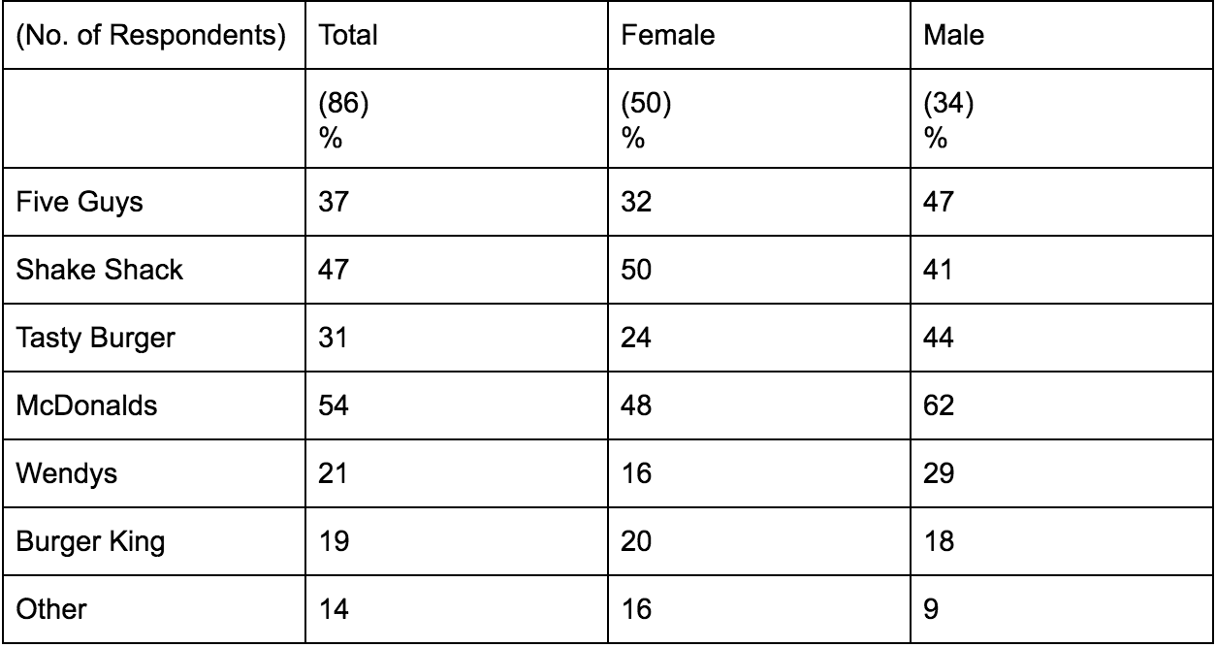
Results (Before Concept Board)
Burger Restaurant Preferences
Notes:
Kent

Slide 12
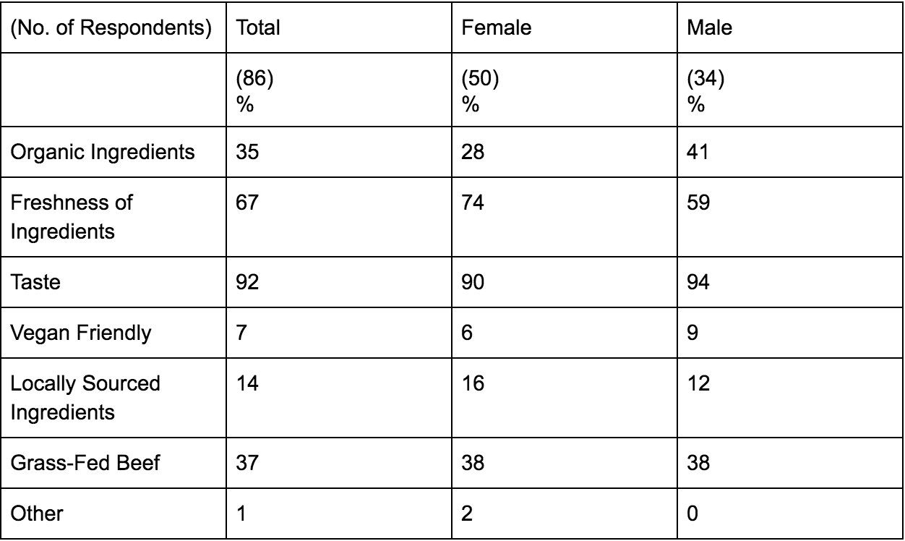
Results (Before Concept Board)
Important Factors in Choosing a Burger

Slide 13
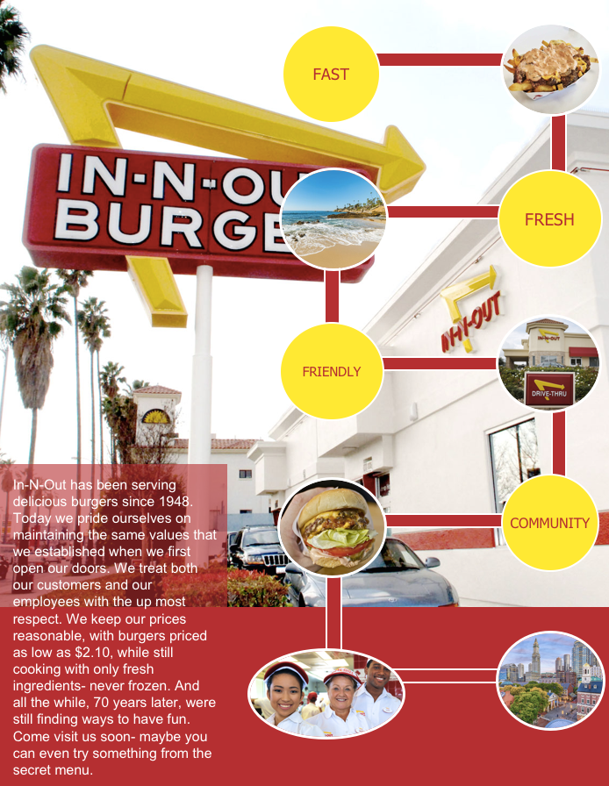

Slide 14
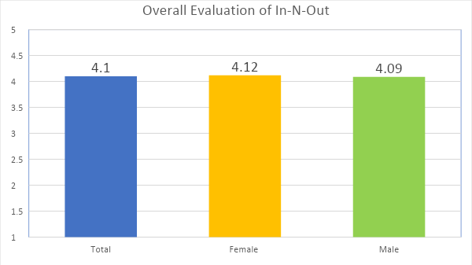
Results (After Concept Board)

Slide 15
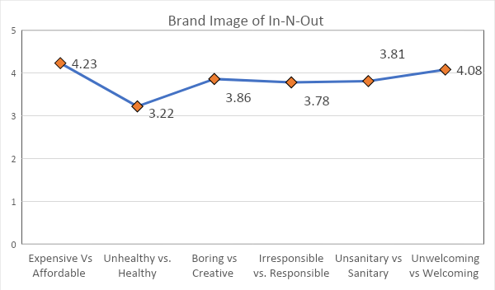
Results (After Concept Board)
Notes:
Kent

Slide 16
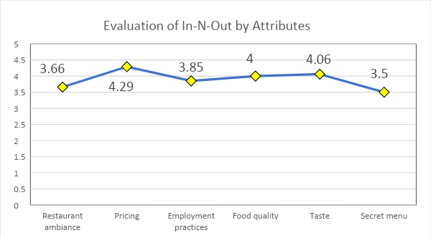
Results (After Concept Board)

Slide 17
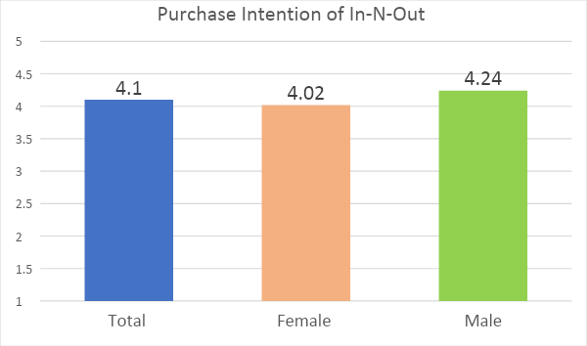
Results (After Concept Board)

Slide 18
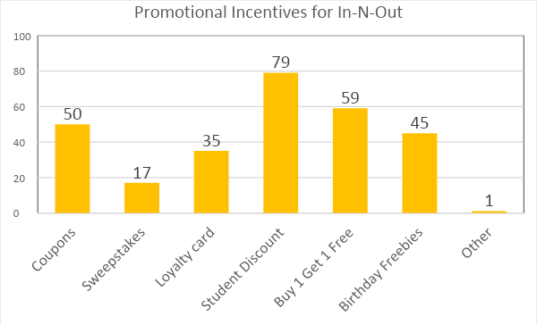
Results (After Concept Board)

Slide 19
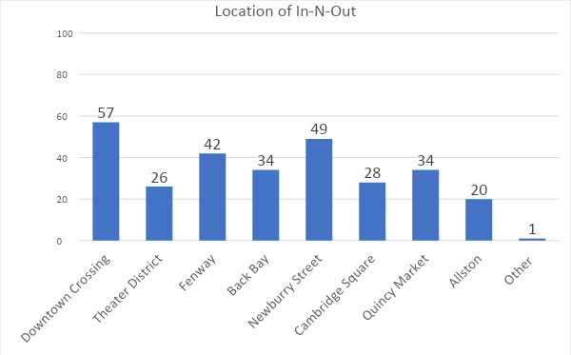
Results (After Concept Board)

Slide 20
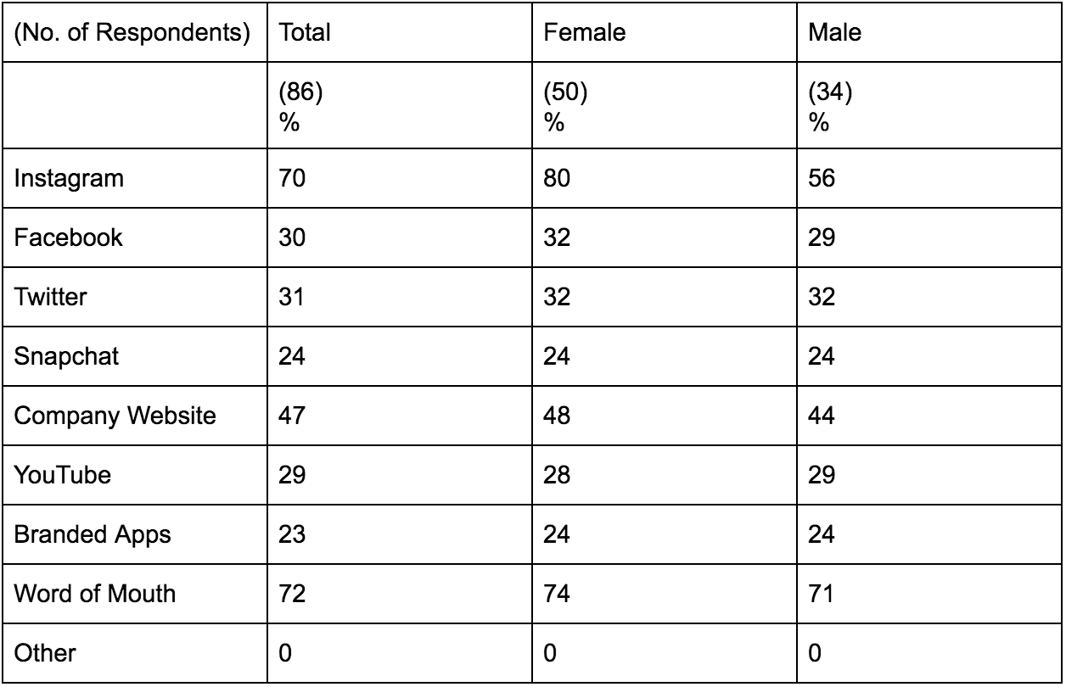
Results (After Concept Board)
Preferred Information Sources for In-N-Out

Slide 21
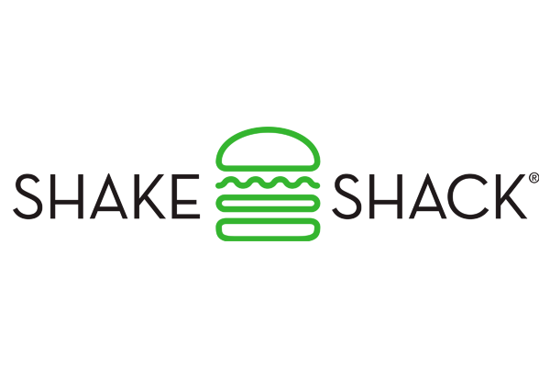
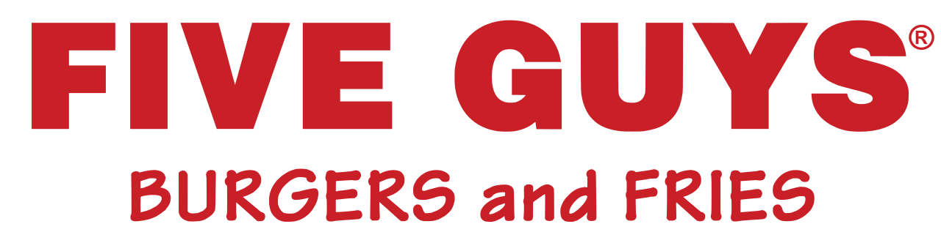
Conclusion
CONSUMPTION PATTERNS
45% of respondents eat at burger restaurants 2-3 a month
Five Guys and Shake Shack were most popular
Willing to spend $8-10
CONSUMER CHARACTERISTICS
Care the most about taste, freshness of ingredients, grass fed beef and organic ingredients

Slide 22
Acceptance of In-N-Out
Overall acceptance of brand? → Very positive
Top 2 Box 76%, 4.1 total mean score
Purchase intention? → Very positive
Top 2 Box 79%, 4.1 total mean score
*We recommend that In-N-Out expand to Boston*

Slide 23
Recommendations
POTENTIAL IMPROVEMENTS
CURRENT PRACTICES
Organic ingredients, grass fed beef
Healthier alternatives
Ambience
Fresh, never frozen
Pricing
Welcoming environment
Targeting → All genders equally with slight leaning towards males.

Slide 24

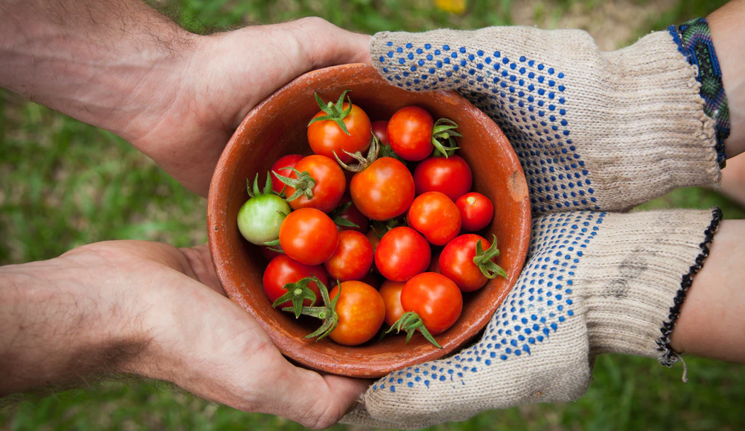
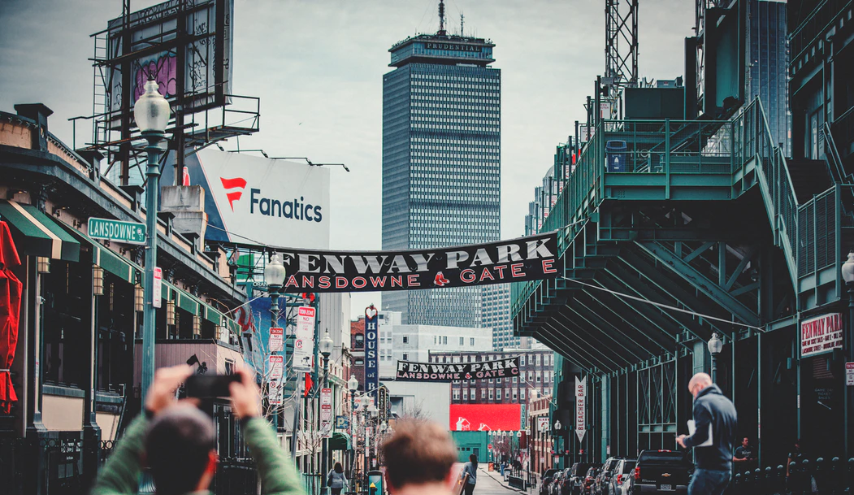

4 P’s
PRICE
Silmar current pricing, $8-10
PRODUCT
Fresh, Great taste
PLACEMENT
Newbury Street, Fenway
PROMOTION
Student Discount, coupon, buy 1 get 1 free

Slide 25
Thank you!

